Slide 1

Negotiated Rulemaking Session
J. Ritchie Morrow
CCPE Financial Aid Officer
March 19, 2026

Slide 2
Disclaimer
Information provided as of today & from Neg Reg session
Final regs have not been posted
  NPRM for loan changes closed
  NPRM for Workforce Pell open
  NPRM for Accountability & COA/PELL not yet open

Slide 3
Agenda
Program Accountability
Workforce Pell
Changes in Loans
Pell/Cost of Attendance

Slide 4
Program Accountability
Addition to PPA
  …if an institution does not comply with the provisions of 34 CFR § 668.16(t) … in two out of any three consecutive award years, the institution will be placed on provisional status and the institution’s low-earning outcome programs shall not qualify for title IV, HEA funds.
§ 668.16(t)
  (the institution) demonstrates that at least half of the institution’s recipients of title IV, HEA funds and at least half of the institution’s total title IV, HEA funds are not from low-earning outcome programs

Slide 5
Program Accountability
Earnings Threshold
  For undergrad programs
    Median earnings of working adults aged 25-34 with only a high school diploma (or equivalent) and who were not enrolled in an eligible institution
  For grad programs
    Median earnings of working adults aged 25-34 with only a baccalaureate degree and were not enrolled in an eligible institution
Working definition – Individuals who are in the labor force, employed, and have a positive non-zero income

Slide 6
Program Accountability
  Median Earnings
    Lowest of the median earnings of working adults
      In the institution’s state
      In same field of study under two- or four-digit CIP in the institution’s state
      In same field of study under two- or four-digit CIP in the nation, or
    If fewer than 50% of student enrolled in institution reside in the institution’s state, lowest of median earning of working adults
      Nationally
      In same field of study under two- or four-digit CIP in the nation
Notes:
Six digit code. 13 – Education, 13.12 – Teacher Education, 13.1202 – Elementary Education

Slide 7
Program Accountability
  A program passes the earnings premium measure if median annual earning of the students who complete program equal or exceed earnings threshold
  A program fails the earnings premium measure if median annual earning of the students who complete program are less than earnings threshold

Slide 8
Example #1: Undergraduate Degree Program
This is an associate degree program at a college in CA, which enrolls most students from in-state.
Since the program’s earnings ($53,872) exceed the earnings benchmark ($36,082), this program passes the new accountability test.

Slide 9
Example #2: Graduate Program
This is a master’s program at a college in NY, which enrolls most students from out-of-state.
Thus, this program’s earnings are compared to the lowest of the National Same-Field Bachelor Degree Benchmark and the National Bachelor Degree Benchmark.
Since the program’s earnings ($46,372) does not exceed the earnings benchmark ($48,304), this program fails the new accountability test.

Slide 10
Program Accountability - Timing
Under proposed rule, first earnings test would be calculated in early 2027
  July 1, 20207 is first year programs could fail earnings test
Second earnings test calculated early 2028
  July 1, 2028 first date programs could lose access to DL

Slide 11
(2) Cohorts used for Earnings Test
“Year of Determination” used for computing earnings in the 2027 Calendar Year
2021
2022
2023
2024
2025
2026
2027
The earnings test for
July 1, 2027
is calculated using completers from the 2021 Award Year

Slide 12
Why use Completers from the 2021 Award Year?
These completers graduate between July 1, 2020 and June 30, 2021.
By December 2025, all graduates from the 2021 award year have been out of college for four years.
In early 2027, tax information filed in April 2026 is pulled (covering earnings from 2025).
Thus, in early 2027, the most recent tax data available covers the 2025 calendar year—which is four years after graduates from the 2021 award year finished college.

Slide 13
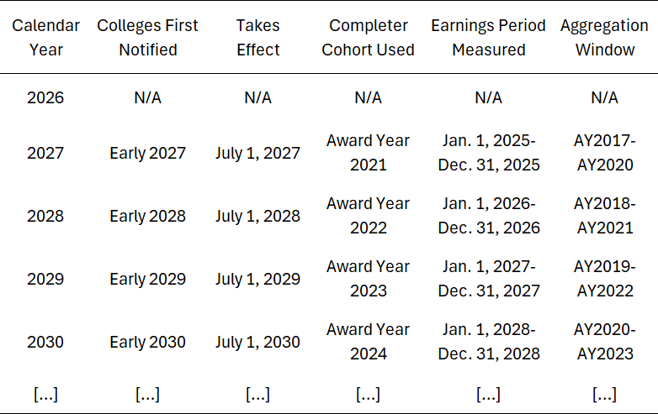
Timeline
If cohort aggregation is needed, earnings for prior cohorts are measured at the same interval (the tax year corresponding to four years after that cohort exits).
The first year programs could lose eligibility for Federal student loans.

Slide 14
Cohort Aggregation Method
For small programs (ex N < 30 Title IV Completers), for up to four prior award years
following the fourth award year prior to the year the most recent earnings data is available:
Aggregate Title IV completers from prior award years from the same OPEID6, Credential Level, and 6-digit CIP code;
If a statistically reliable cohort size is not achieved, aggregate Title IV completers from prior award years from the same OPEID6, Credential Level, and 4-digit CIP code;
If a statistically reliable cohort size is not achieved, aggregate Title IV completers from prior award years from the same OPEID6, Credential Level, and 2-digit CIP code.
If at least 30 Title IV completers is still not achieved after following steps #1, #2, and #3, the program is exempt from the earnings test.
Notes:
ED not sure on # of Completers; during Neg Reg estimated 30-50

Slide 15
Illustrative Example of Cohort Aggregation
Using the same Credential Level and OPEID6:
Start
(1)
(2)
(3)
(4)
Aggregate
using
6-digit
2025
2024
2023
2022
2021
CIP
Aggregate
using
4-digit
2021 | 2022 | 2023 | 2024 | 2025
(9) | (8) | (7) | (6) | (5)
2025 | 2024 | 2023 | 2022 | 2021
CIP
Aggregate
using
2-digit
End
CIP
(10)
(11)
(12)
(13)
(14)

Slide 16
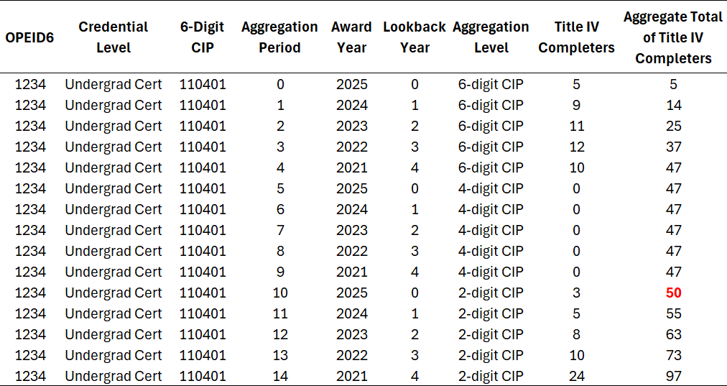
Illustrative Example of Cohort Aggregation
If 50 is the threshold to achieve a statistically reliable cohort size, then the aggregation would stop at Step 10.

Slide 17

Cohort Aggregation Will Be Common
Share of Programs (CIP6) with More Than 30 Title IV Completers in a Single Award Year, by Credential Level
Overall, only 9% of programs have greater than 30 Title IV completers in a single award year
100%
80%
Percent
60%
40%
This means 91% of programs will need to be aggregated with prior cohorts
35.6
20%
12.1
7.0
6.3
8.5
3.0
0%
1.2
2.1
Ug Cert
Associate
Bachelors Post-Bacc Cert Masters
Doctoral
Prof
Grad Cert

Slide 18
Program Accountability
Program must fail 2 out of 3 years to lose Direct Loan eligibility
If fails year 1 institution has two options:
  Roll the dice and hope program passes year 2
  Commit to teach out option
    Maintain DL eligibility for three years to teach out currently enrolled students
    Must notify accreditor & state board

Slide 19
Other Accountability Items
Institutions will need to provide data to ED yearly
Institutions will be allowed to review list of completers prior to calculation
Excluded students

Slide 20
Fail Rate, by State
Program-Weighted
Figure 8. Fail Rates by State, OBBB Test + Modified GE Regs
20%
15%
Percent of Programs
10%
5%
0%
16
LA
MS
FL UT CA AK TN CO ID TX OR GA VA OH WA AR OK MD SC NV AZ ME WV NM IL MA NY NJ NC PA MI VT KY IA DE KS MO SD CT WI MN AL IN MT HI NE NH RI ND WY DC

Slide 21
Pass/Fail Rate, by State
Student-Weighted
Figure 9. Fail Rates by State, OBBB Test + Modified GE Regs
20%
Percent of Title IV Students
5%
0%
17
FL
ME WA LA TN MN CA ID NV GA TX OH NY MS MI KS CO AK PA NJ NM OR VA MA WV SC AR IL MD OK CT NC MO AZ KY RI HI IN UT WI VT SD IA NE MT AL WY DC DE ND NH

Slide 22
Most Common Undergraduate Certificate Programs That Fail
Student-Weighted
Figure 10. Pass/Fail Rates by CIP4, OBBB Test + Modified GE Regs
Culinary Entertainment and Personal Services Other. English Language and Literature General.
Computer and Information Sciences and Support Services Other. Cosmetology and Related Personal Grooming Services. Somatic Bodywork and Related Therapeutic Services. Human Development Family Studies and Related Services. Radio Television and Digital Communication.
Dental Support Services and Allied Professions. Business Operations Support and Assistant Services.
Teacher Education and Professional Development Specific Levels and Methods.
Audiovisual Communications Technologies/Technicians. Allied Health and Medical Assisting Services.
100.0
98.9
95.9
92.5
100% of Title IV students in undergraduate certificate programs in “Culinary Entertainment, Other” fail the proposed rule.
89.0
77.2
62.6
58.9
57.7
55.6
55.6
50.0
0%
20%
40%
60%
80%
100%
Percent of Title IV Students
Passes
Fails (OBBB + Modified GE)
18

Slide 23
Most Common Associate Degree Programs That Fail
Student-Weighted
Figure 11. Pass/Fail Rates by CIP4, OBBB Test + Modified GE Regs
Somatic Bodywork and Related Therapeutic Services. Cosmetology and Related Personal Grooming Services.
Film/Video and Photographic Arts.
Fine and Studio Arts. English Language and Literature General.
Human Development Family Studies and Related Services.
Visual and Performing Arts General. Graphic Communications.
Music. Audiovisual Communications Technologies/Technicians.
Human Services General. Design and Applied Arts.
Health and Medical Administrative Services.
100.0
100.0
100% of Title IV students in associate degree programs in “Somatic Body Work & Related” and “Cosmetology & Related” fail the proposed rule.
79.4
73.8
69.9
48.2
46.7
39.6
38.6
33.2
30.2
29.9
29.6
0%
20%
40%
60%
80%
100%
Percent of Title IV Students
Passes
Fails (OBBB + Modified GE)
19

Slide 24
Most Common Bachelor Degree Programs That Fail
Student-Weighted
Figure 12. Pass/Fail Rates by CIP4, OBBB Test + Modified GE Regs
Religion/Religious Studies.
53.3
Graphic Communications.
17.7
Film/Video and Photographic Arts.
12.0
Drama/Theatre Arts and Stagecraft.
11.4
53% of Title IV students in bachelor degree programs in “Religion/Religious Studies” fail the proposed rule.
Music.
11.0
Human Development Family Studies and Related Services.
10.0
Rhetoric and Composition/Writing Studies.
9.8
Fine and Studio Arts.
8.5
Design and Applied Arts.
3.3
Liberal Arts and Sciences General Studies and Humanities.
0%
20%
40%
60%
80%
100%
Percent of Title IV Students
Passes
Fails (OBBB + Modified GE)
20

Slide 25
Most Common Master’s Degree Programs That Fail
Student-Weighted
Figure 13. Pass/Fail Rates by CIP4, OBBB Test + Modified GE Regs
Alternative and Complementary Medicine and Medical Systems.
98.1
98% of Title IV students in master’s degree programs in “Alternative & Complimentary Medicine” fail the proposed rule.
Religion/Religious Studies.
89.4
Mental and Social Health Services and Allied Professions.
64.3
Fine and Studio Arts.
44.1
Music.
41.8
0%
20%
40% 60%
Percent of Title IV Students
80%
100%
Passes
Fails (OBBB + Modified GE)
21

Slide 26
Workforce Pell
Not a new Title IV financial aid program
Is a new way to award Pell Grant
Student must meet all Pell Grant eligibility requirements
  FAFSA
  Verification
  C-flag
  Pell ISIR Flag set to ‘Y’

Slide 27
Workforce Pell
Eligible Workforce Pell Program is:
  Minimum 8 weeks but less than 15 weeks, and
  At least:
    150 but less than 600 clock hours, or
    4 but less than 16 semester or trimester hours, or
    6 but less than 24 quarter hours
      (If student attends part-time (i.e. takes 16 weeks to complete 8-week program WFP can be spread out)
  Approved by Governor or designee
  Approved by ED Secretary
  Complies with Value-added Earnings
  Offered by an institution that has not been subject to any suspension, emergency action, or termination

Slide 28
Workforce Pell
Eligible Workforce Pell Program:
  Is subjected to two payment periods
  Must be included in Satisfactory Academic Progress calculation
  Must have Return to Title IV (R2T4) calculation done for students that do not complete program

Slide 29
Workforce Pell
Eligible Workforce Pell Program is not:
  Remedial coursework
  Correspondence course
  Study abroad program
  Part of a direct assessment program
Can be awarded to a student that has earned a bachelor’s degree
  Student is not eligible for other Title IV aid

Slide 30
Workforce Pell
Workforce Pell & Regular Pell cannot be awarded at same time
Workforce Pell & Regular Pell can be awarded in same payment period
In Consumer Material (website, brochures, etc.) for Workforce Pell program institution is required to explain how Workforce Pell award will affect Pell Lifetime Eligibility Used (LEU)

Slide 31
Workforce Pell – Governor (or Tribal Government) Approval Process
Must consult with state workforce board
Program aligned with high-skill, high-wage (Carl Perkins Career & Technical Education Act), or in-demand occupation
Meets hiring requirements of prospective employers
Must be:
  stackable & portable, or
  prepares student for employment in occupation for which there is only one recognized postsecondary credential
Meets Value-added Earnings calculation

Slide 32
Workforce Pell – Governor (or Tribal Government) Approval Process
Must reapprove program every two years or upon expiration of institution’s Program Participation Agreement
Must make publicly available criteria which will be used to determine eligible program, which includes:
  Information an institution must submit to Governor
  Process & timeline for Governor to make decision
  Appeal process
  Attestation that workforce board has been consulted

Slide 33
Workforce Pell – Governor (or Tribal Government) Submission to Secretary
Name of Program
Program’s CIP code
Employer SOC code
Statement that program meets & has met for previous 12 months eligibility requirements
Date program was approved
Agreement that Governor will make to ED &/or Labor Secretary upon request:
  Process for making determination of program approval
  Process for withdrawing program approval

Slide 34
Workforce Pell – Governor (or Tribal Government) to Governor Agreement
Governors of two states may enter into agreement, so long as:
  Agreement is published publicly
  Governor in which student is located, in consultation with workforce board, includes approved occupation or sector
  Governor in which institution is located meets eligibility conditions
  Agreement includes provisions for data-sharing

Slide 35
Workforce Pell – Secretary Approval Process
Confirms program in existence for minimum 12-months
Meets placement & completion rates
  For 2026-27, 2027-28, and 2028-29
    Completion rate of 70% within 150% timeframe
    Job placement rate of 70% within second quarter after exiting program
  For 2029-30 and on
    Completion rate of 70% within 150% timeframe
    Job placement rate of 70% within second quarter after exiting program within educated or comparable occupation
Confirms program’s published tuition & fees do not exceed value-added earnings no later than three months prior to award year

Slide 36
Workforce Pell – Institution Data Submitted to Governor (or Tribal Government)
After program is approved, institution must submit yearly:
  To Governor
    List of students that completed program during previous award year*
    Information necessary for Governor to verify job placement rate
  To Secretary
    Published tuition & fees
*Excluded students
  Death
  Medical condition which prevents employment
  Order to military service for period longer than 30 days
  Incarcerated

Slide 37
Workforce Pell – Value Added Earnings
Program’s total tuition and fees may not exceed Value-Added Earnings of students who are working, received Pell Grant, and completed program
  First year (and second year if needed) – N ≥ 50
  First, second, and third year – N ≥ 30
  If N < 30 VAE not calculated
VAE calculated by difference between:
  Median earnings adjusted by price parities, and
  150% of poverty for a single person
Tuition & fees must be equal to or less than VAE
Programs with tuition & fees greater than VAE not eligible for Workforce Pell
Notes:
Remember – first 3 years is just working; after first 3 years working is defined as in area were educated

Slide 38
Obtaining Median Earnings: Example 1. 2029-30 Award Year
The process begins at least 6 months prior to the beginning of the 2029-30 award year.
To obtain a list of median earnings from the Federal agency with earnings data the Department will compile a list of at least 50 individuals that completed the program during the 2026-27 award year.
University of XYZ has 70 completers in the 2026-27 award year. Thus, the Department does not need to add completers from the prior award year because there are more than 50.

Slide 39
Value-Added Earnings: Example 1
College | State | 3-Year Median Earnings | Regional Price Parity Index | Adjusted 3-Year Median Earnings | 150% of Federal Poverty Line | Value-Added Earnings
XYZ University | AR | $25,000 | 86.5 | $28,902 | $21,780 | $7,122
Adjusted Median Earnings = ($25,000/86.5) * 100 = $28,902
Value Added Earnings = ($28,902 - $21,780) = $7,122

Slide 40
Obtaining Median Earnings: Example 2.
2032-33 Award Year
University of ABC has 10 completers in the 2029-30 Award Year; ED must add completers from the prior award year.
There are 30 completers in the 2028-29 award year. Total completers from the two award years equals 40 for University of ABC. ED must add completers from the prior award year.
There are 15 completers from the 2027-28 award year. Total completers from the three award years equals 55. This is a sufficient number of completers for University of ABC, and the process stops.

Slide 41
Value-Added Earnings:
Example 2
College | State | 3-Year Median Earnings | Regional Price Parity Index | Adjusted 3-Year Median Earnings | 150% of Federal Poverty Line | Value-Added Earnings
ABC University | AK | $29,000 | 101.7 | $28,515 | $27,315 | $1,200
Adjusted Median Earnings = ($29,000/101.7) * 100 = $28,515
Value Added Earnings = ($28,515 - $27,315) = $1,200

Slide 42
Workforce Pell – Calculating Credit Hour Program
Student eligible for $5,395 Pell (SAI=2000)
School academic year is 24 semester hours & 30 weeks of instruction
Student enrolls in 10 semester hour program, enrolled in 10 instruction weeks
Institution must do clock-credit hour conversion since program does not lead to degree
Since program’s payment periods are not standard terms school must calculate Pell amount using Pell Formula 3

Slide 43
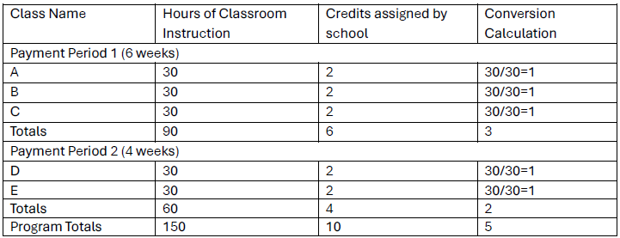
Workforce Pell – Calculating Credit Hour Program (cont)

Slide 44

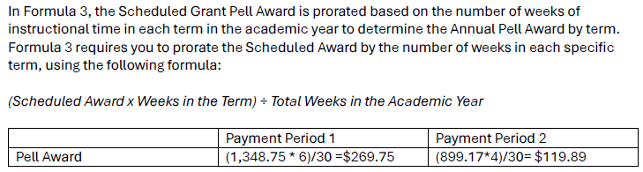
Workforce Pell – Calculating Credit Hour Program (cont)
Notes:
Award can be less than regular minimum Pell

Slide 45
Workforce Pell
Workforce Innovation & Opportunity Act (WIOA) funds must be awarded after any Workforce Pell funds are awarded
Institution must repay Pell if funds disbursed and then it’s determined program is ineligible
Can be awarded for programs that require assistantship, but Workforce Pell funds can only be used for classroom portion of program
  Classroom work can be interspersed with assistantship

Slide 46
Loan Changes
Beginning July 1, 2027, a defaulted student loan borrower may rehabilitate their defaulted loan(s) twice
Income Based Repayment Plan – 15% of the amount of a student’s (and if applicable student’s spouse) AGI that exceeds 150% of poverty rate

Slide 47
Loan Changes – Less than FT Enrollment
Loans must be prorated for any student enrolled less than full-time
For students enrolled in the Academic Year
  (Number of Credit Hours Enrolled for Academic Year ÷ Number of Credit Hours Considered FT for the AY) X 100
    Rounded to nearest whole percentage point

Slide 48
Loan Changes – Institutional Loan Limits
Beginning July 1, 2026, an institution may limit total amount of loans a student (or student’s parent) may borrow for a specific program of study
Prior to implementation institution must:
  Document decision
  Provide clear information and explain decision to current and potential students
    Course Catalog
    Website
    Award Notification

Slide 49
Loan Changes – Payment Postponement
For loans disbursed on or after July 1, 2027, students:
  May not receive
    an unemployment deferment
    an economic hardship deferment
  May receive a forbearance for a period that does not exceed nine months within a 24-month period

Slide 50
Pell/COA
If non-federal sources of aid is equal to or greater than COA then student is ineligible for Pell
  State aid
  Private aid
  Institutional aid
  Does not include emergency aid
If prior to final disbursement of Pell the institution becomes aware that student has or will receive aid equal to or in excess of COA then institution must
  Reduce non-Federal aid, or
  Return all Pell funds received by student

Slide 51
Pell/COA
Test case: Semester based institution, disburses aid in August and January
Initial package (no aid disbursed):
  COA - $20,000
  Non-federal aid - $19,000
  Pell Grant - $5,000
Can student keep Pell?
YES!

Slide 52
Pell/COA
Test case: Semester based institution, disburses aid in August and January
Initial package:
  COA - $20,000
  Non-federal aid - $19,000
  Pell Grant - $5,000
Notified of $2,000 outside scholarship in October
Can student keep Pell?
Either non-federal aid needs to be reduced, or all Pell must be canceled

Slide 53
Pell/COA
Test case: Semester based institution, disburses aid in August and January
Initial package:
  COA - $20,000
  Non-federal aid - $19,000
  Pell Grant - $5,000
Notified of $2,000 outside scholarship in April
Can student keep Pell?
Yes!

